Slide 1

APPLICATION FOR RECOGNITION OF PROSTHODONTIC SPECIALISATION
Dr Name Surname
Case Presentation n. 0

Slide 2
GUIDELINES for USING this template
THis template should be considered as a guide and not A STRICT FRAMEWORK
YOU MAY USE YOUR OWN Template but all mandatory information AND images should be recorded
YOU MAY USE YOUR OWN CHARTS AND RECORDING INDICES
INFormation on slides WILL BE MARKED AS:
MANDATORY:
IF INDICATED:
EPA
MASTER IN PROSTHODONTIC SCIENCES
università di SIENA

Slide 3
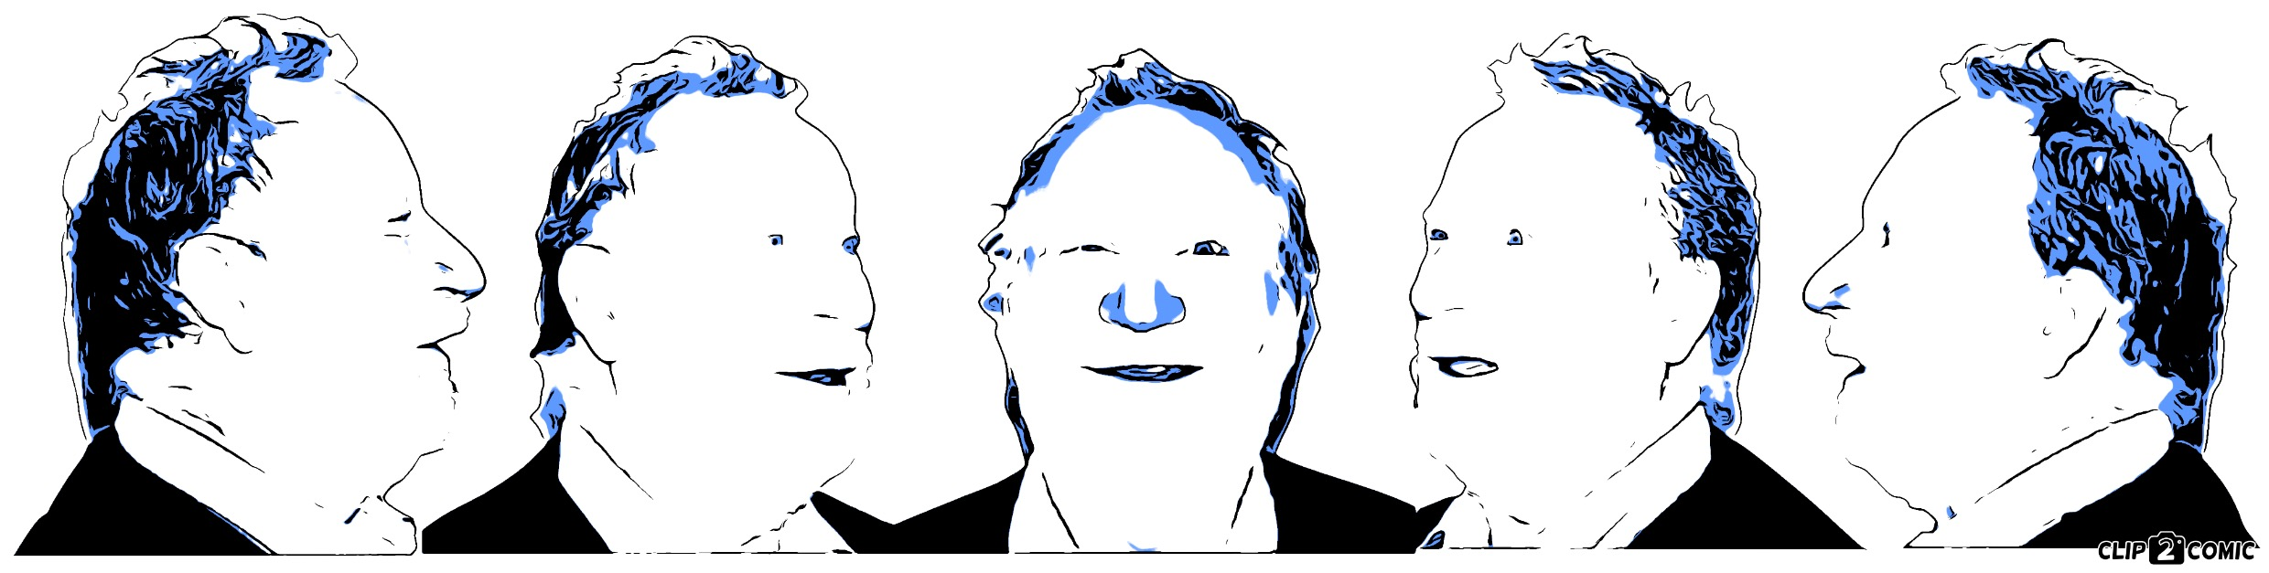
PATIENT INTRODUCTION
AGE:
OCCUPATION:
CHIEF COMPLAINT:
“ …"
SECONdary complaints:
“ …"
EPA

Slide 4
SOCIAL HISTORY
SmoKING:
AlcohoL:
Barriers To Dental Care:
Lifestyle Factors:
EPA

Slide 5
MEDICAL HISTORY
Relevant Medical ComplaintS:
-
-
-
current MEDICATIONS:
-
-
-
ASA SCORE:
EPA

Slide 6
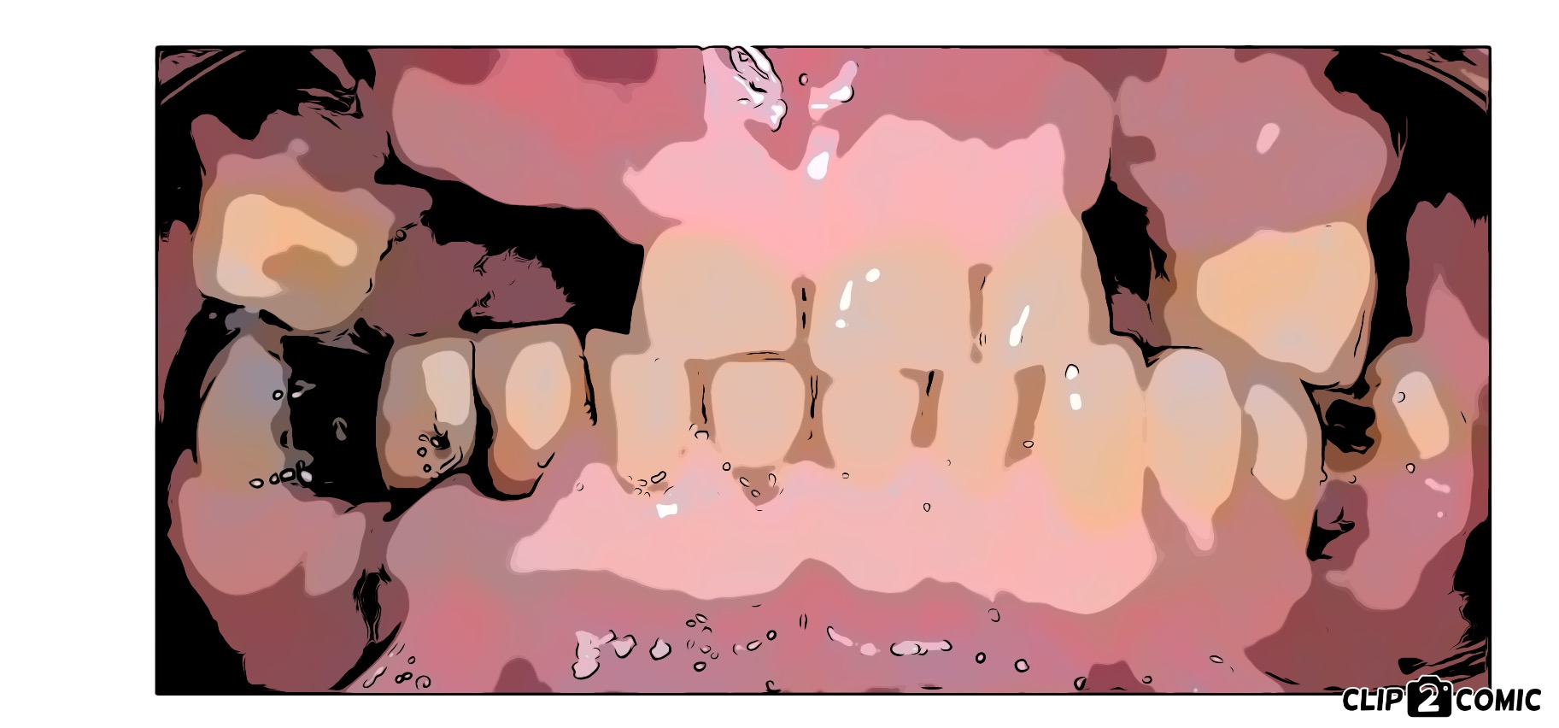
DENTAL HISTORY
LAST visit to dentist:
last hygiene visit:
oral hygiene habits:
Relevant Dental Anamnesis:
Chronological Breakdown and reasons for tooth loss:
Patient Wishes:
Patient Attitude towards Dentistry:
EPA

Slide 7
Extraoral exam
HARD TISSUES:
SOFT TISSUES:
TMJ SIGNS & SYMPTOMS:
SKELETAL CLASSification:
EPA

Slide 8
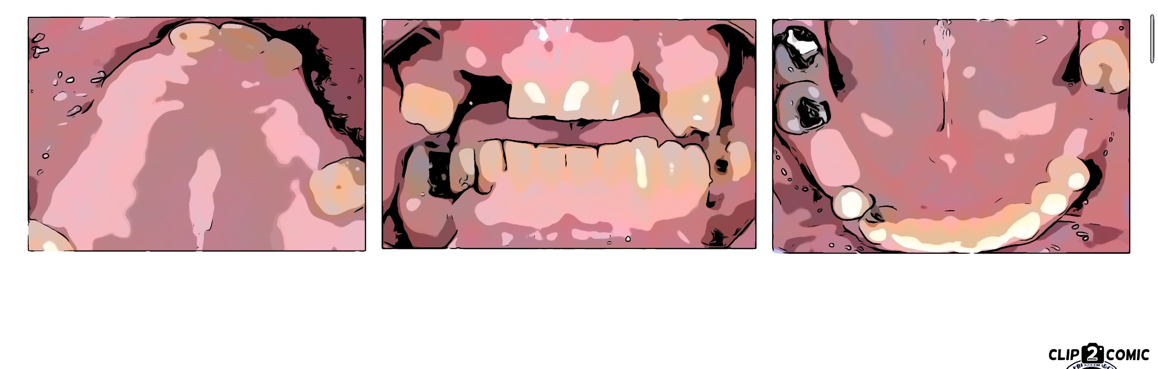
intraoral examination
RELEVANT Findings (FRONTAL views):
EPA

Slide 9
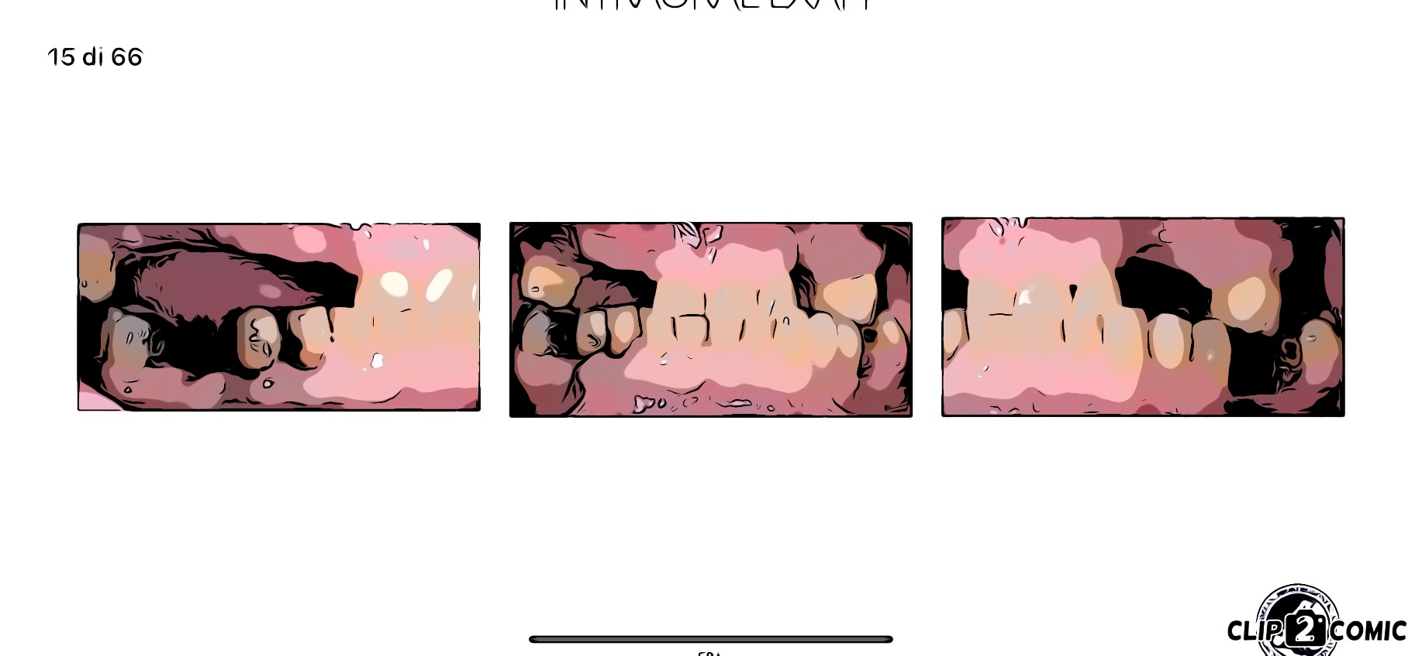
intraoral examination
RELEVANT Findings (lateral views):
EPA

Slide 10
intraoral examination
RELEVANT Findings (occlusal views):
EPA

Slide 11
intraoral examination
RELEVANT Findings (front and lateral views):
alternative display
EPA

Slide 12
intraoral examination
RELEVANT Findings (occlusal views):
alternative display
EPA

Slide 13
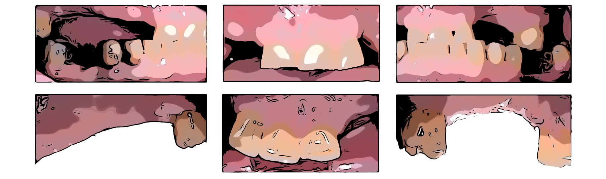
intraoral examination
RELEVANT Findings (other views):
EPA

Slide 14
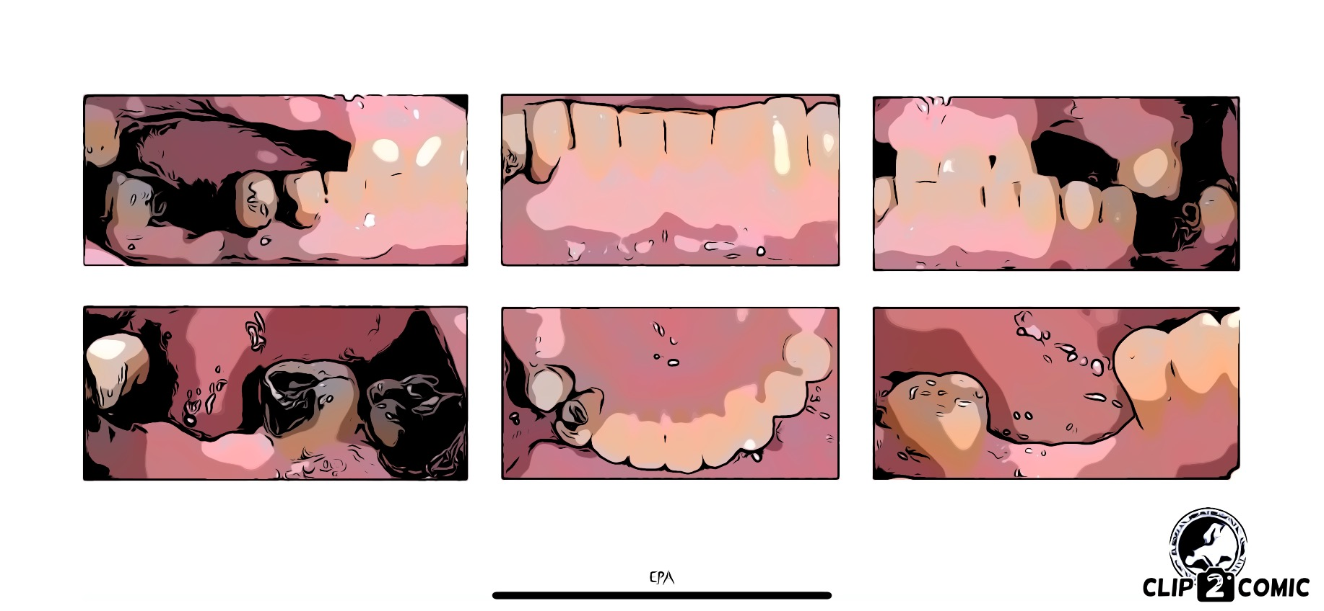
intraoral examination
RELEVANT Findings (other views):
EPA

Slide 15
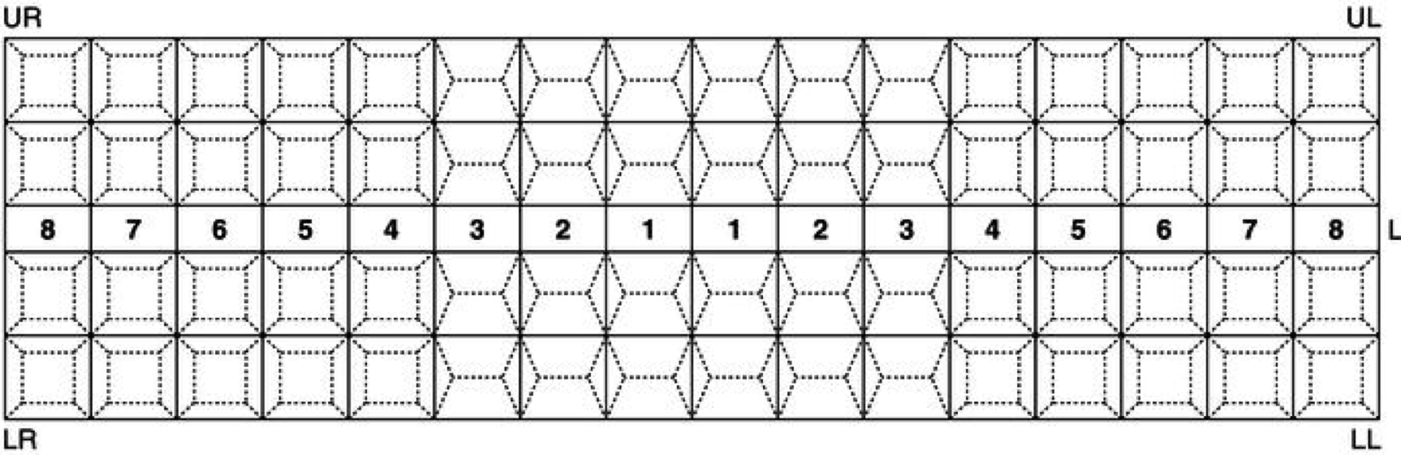
intraoral examination
Baseline Dental Chart
EPA

Slide 16
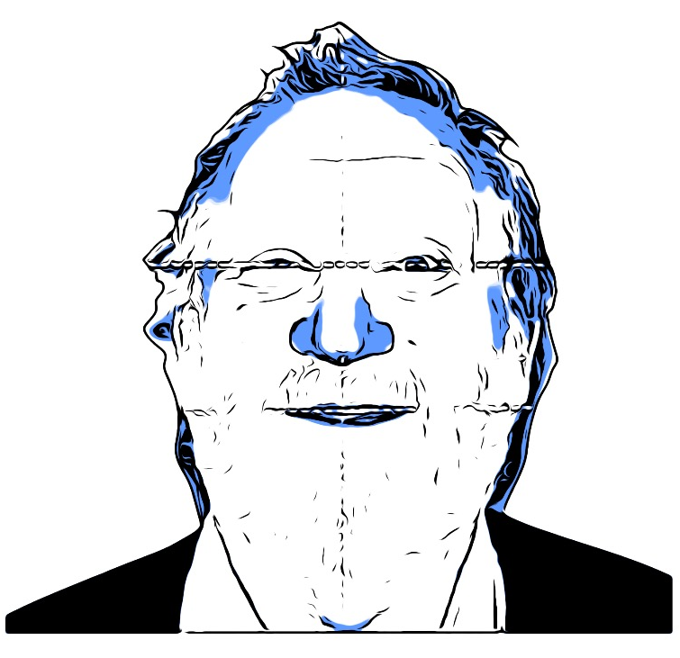
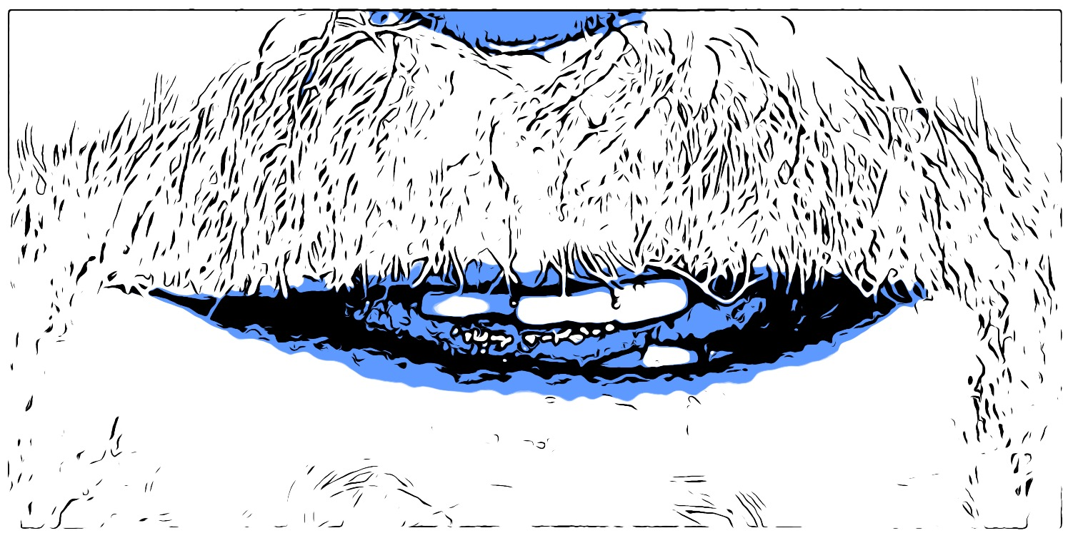
aEsthetic evaluation
asymmetry
VERTICAL DIMENsION
smile line
TOOTH DISPLAY
EPA

Slide 17
aesthetic evaluation
FACIAL & DENTO-LABIAL ANALYSIS
EPA

Slide 18
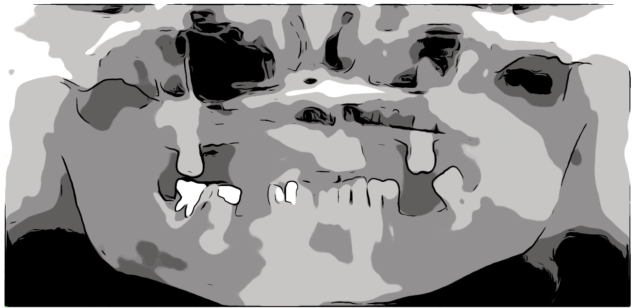
radiographic examination
RELEVANT Findings:
orthopantomography
when indicated
EPA

Slide 19
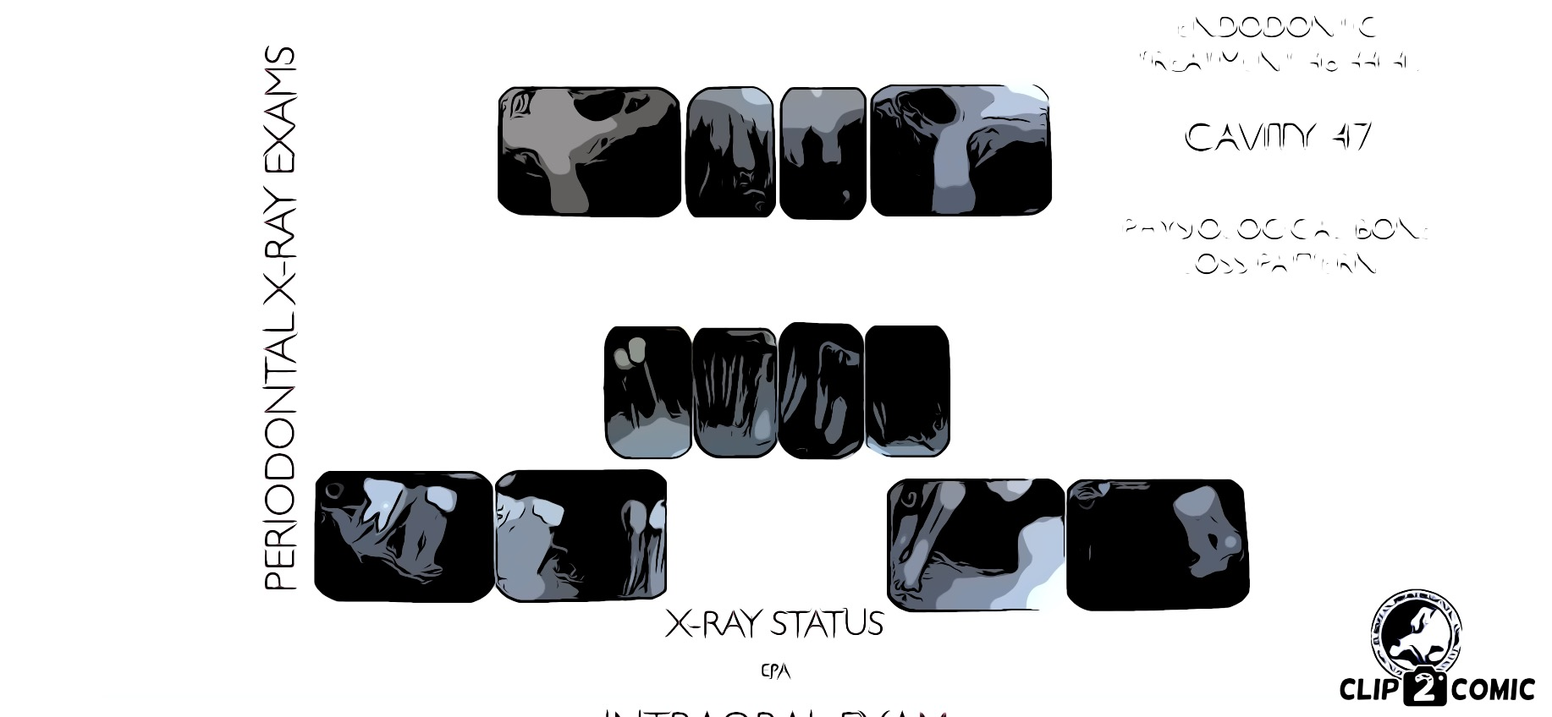
radiographic examination
RELEVANT Findings:
full status
when indicated
EPA

Slide 20
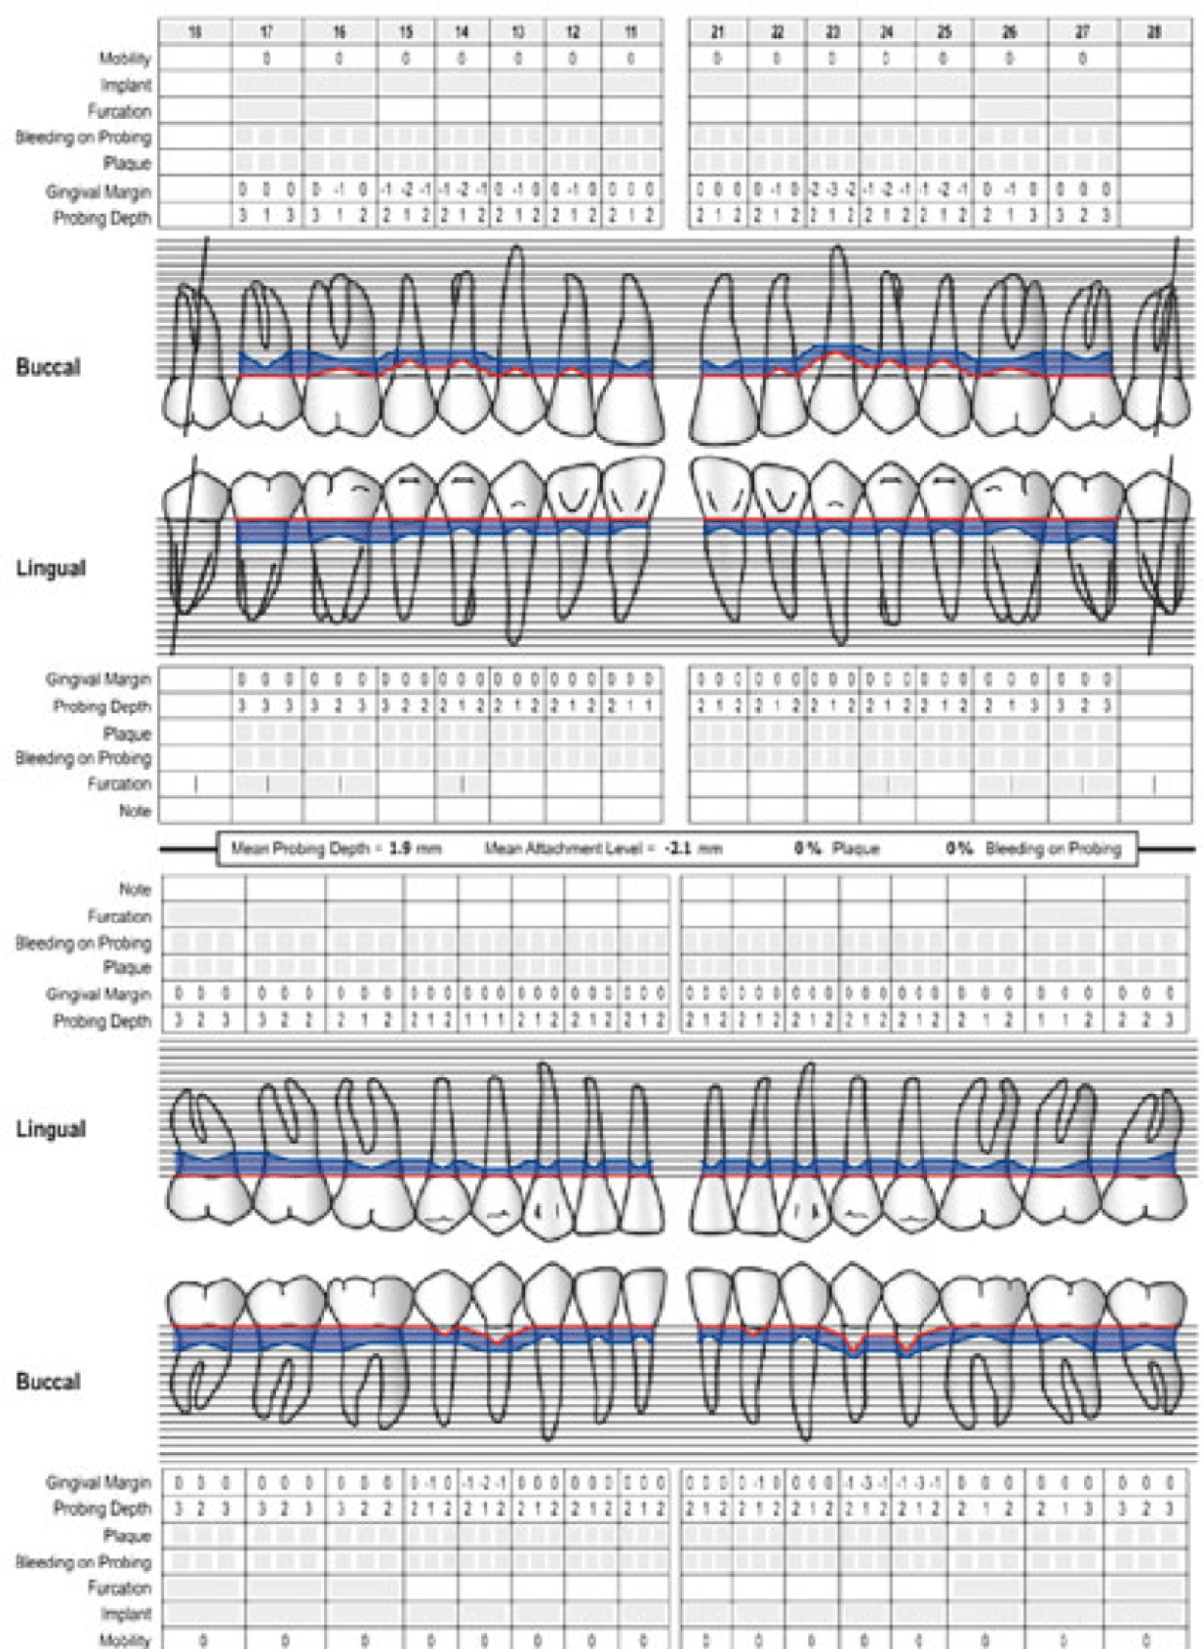
PERIODONTAL CHARTING
EPA

Slide 21
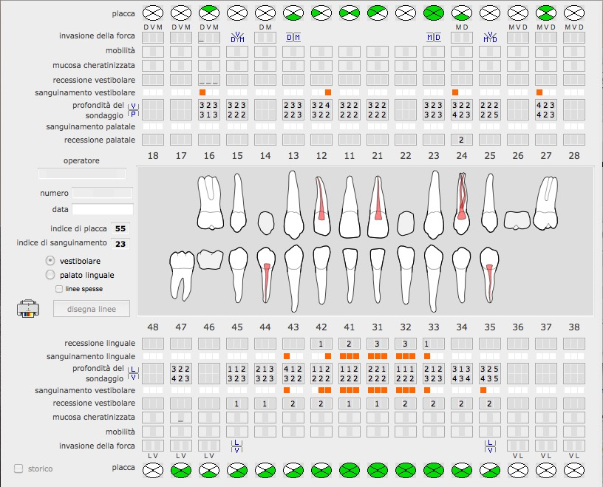
PERIODONTAL CHARTING
alternative (computer generated)
EPA

Slide 22
PERIODONTAL EXAMINATION
RELEVANT periodontal Findings:
if needed to complete charting
EPA

Slide 23
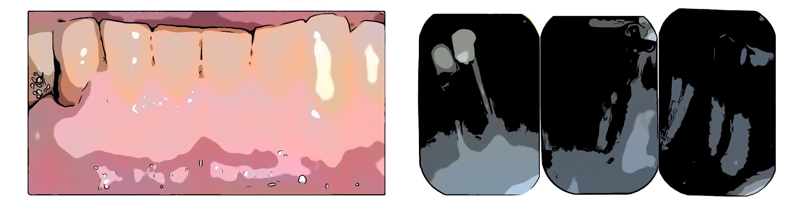

intraoral examination
sextant views
(example)
EPA

Slide 24
intraoral examination
SENSIBILITY TESTING
PERCUSSION
EPT/ THERMAL
EPT/ THERMAL
PERCUSSION
8 | 7 | 6 | 5 | 4 | 3 | 2 | 1 | 1 | 2 | 3 | 4 | 5 | 6 | 7 | 8
PERCUSSION
EPT/ THERMAL
EPT/ THERMAL
PERCUSSION
EPA

Slide 25
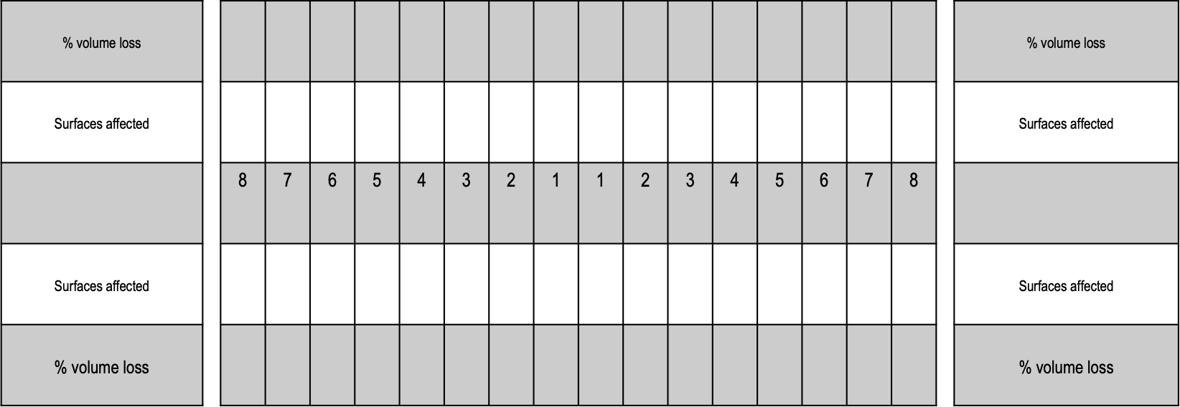

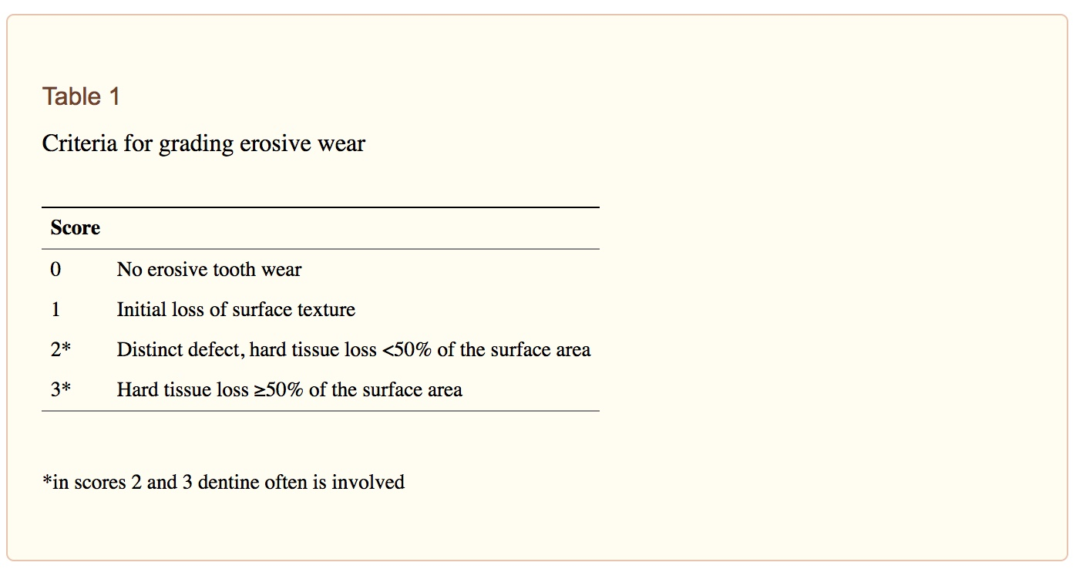
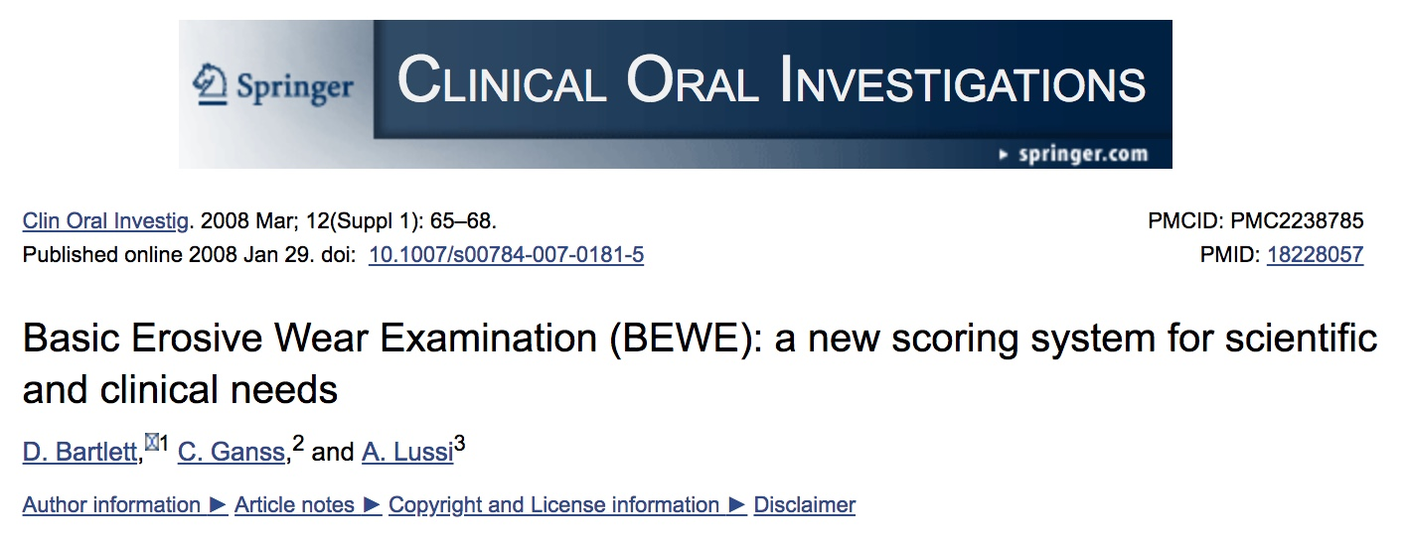
intraoral examination
TOOTH WEAR INDICES
EPA

Slide 26
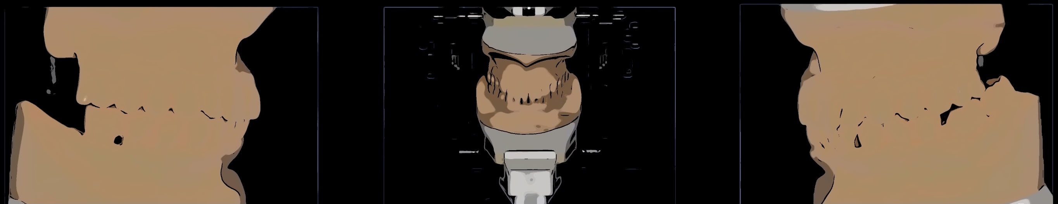
ARTICULATED STUDY MODELS
OCCLUSION: description of occlusal problems
- static:
- DynamIc:
EPA

Slide 27
DIAGNOSIS
LIST OF DISEASES & PROBLEMS:
(Periodontal, Caries, Endodontic, Tooth Wear, Failing Restorations, Occlusal problems, Prosthetic problems, esthetic PROBLEMS, TMD, etc.)
EPA

Slide 28
PROGNOSIS
risk assessment:
(overall prognosis, single tooth prognosis, chosen & alternative therapies outcomes, etc.)
EPA

Slide 29
treatment plan
sequence OF therapies:
Initial phase
re-evaluation
pre-prosthetic therapies
re-evaluation
prosthEtic therapy
EPA

Slide 30
treatment plan
Considerations:
rationale for treatment
justifications
alternative treatments
EPA

Slide 31
prosthodontic planning
description:
Facebow RecorD
Jaw Registration
Articulation
Digital Planning
Mock Wax Ups
Transfer StentS
EPA

Slide 32
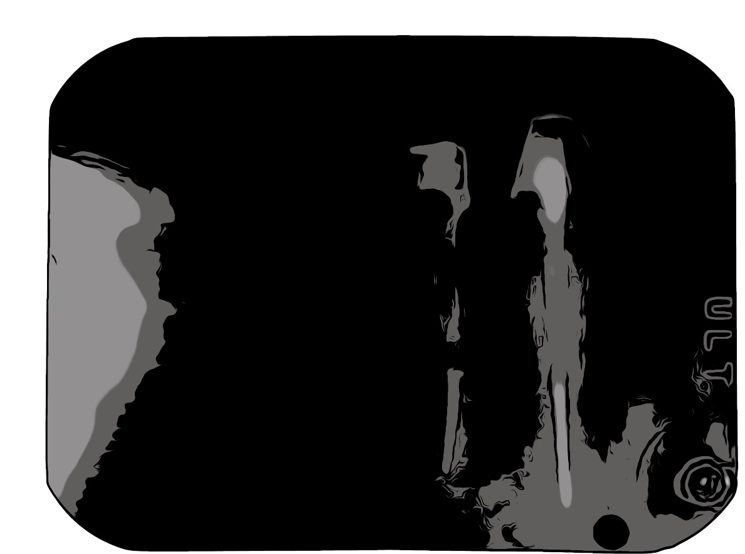
treatment
Pre-prosthetic treatments
EXAMPLE: ENDODONTIC TREATMENT OF 4.3
description of therapies
overview
EPA

Slide 33
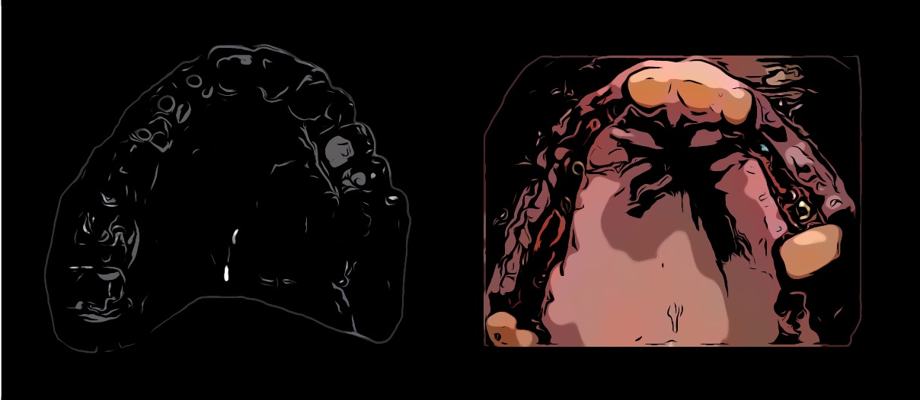
treatment
Pre-prosthetic treatments
EXAMPLE: FIRST STAGE SURGERY
description of therapies
overview
EPA

Slide 34
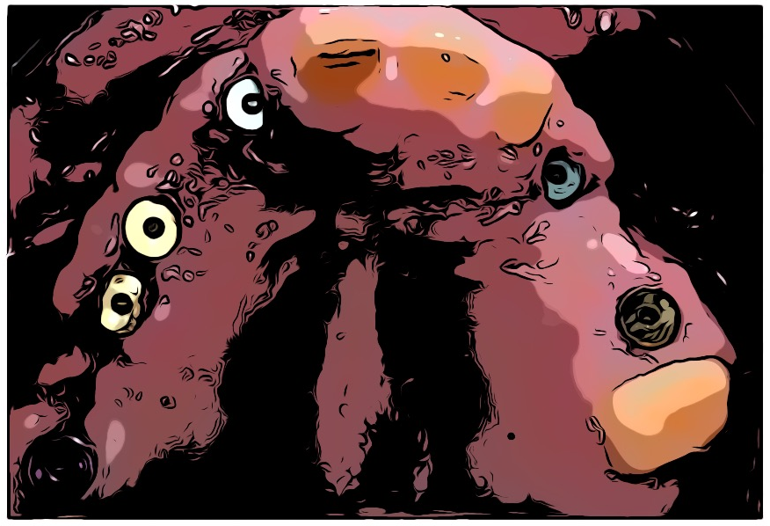
treatment
Pre-prosthetic treatments
EXAMPLE: SECOND STAGE SURGERY
description of therapies
overview
EPA

Slide 35
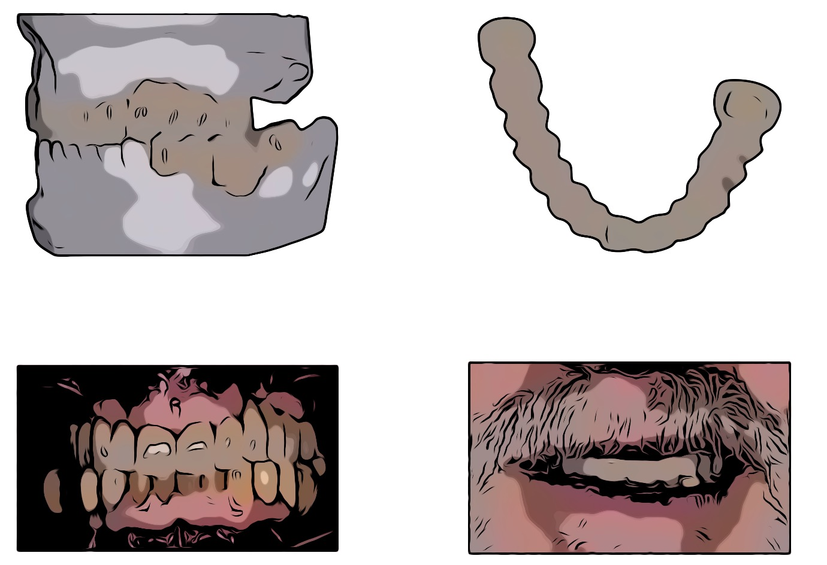
treatment
PROVISIONAL RESTORATIONS
description of technique (chair-side, laboratory custom made, etc.)
EPA

Slide 36
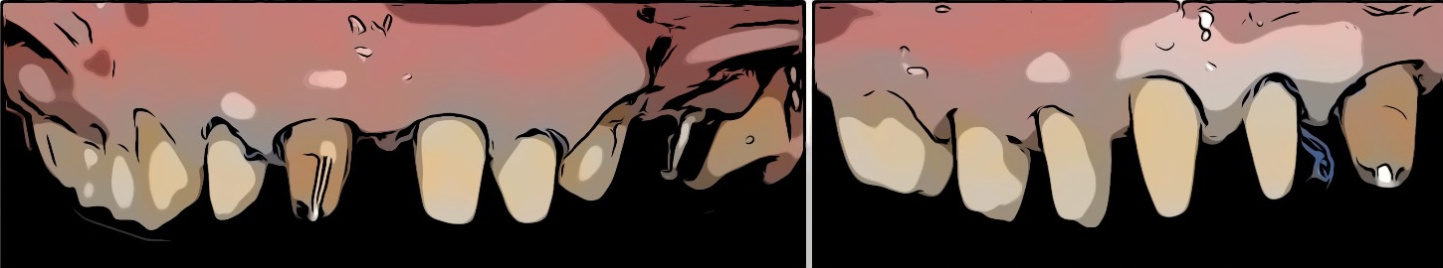
treatment
TOOTH PREPARATIONS
description of technique (margin design, etc.)
EPA

Slide 37
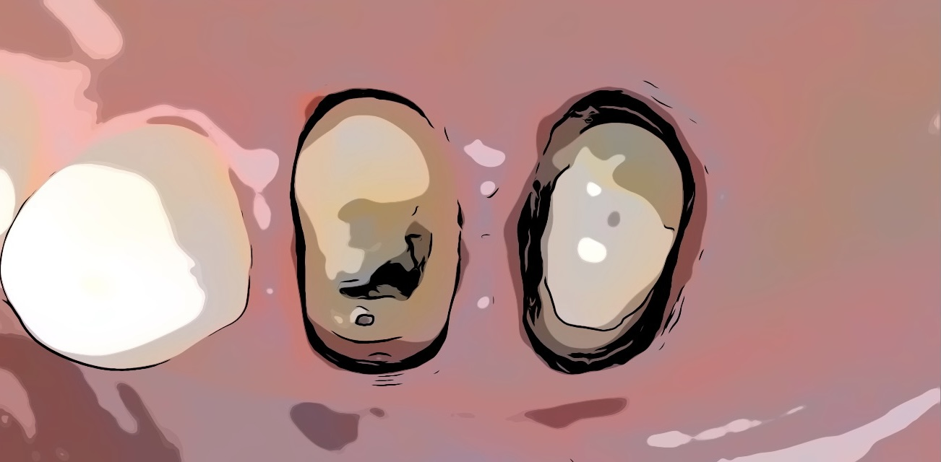
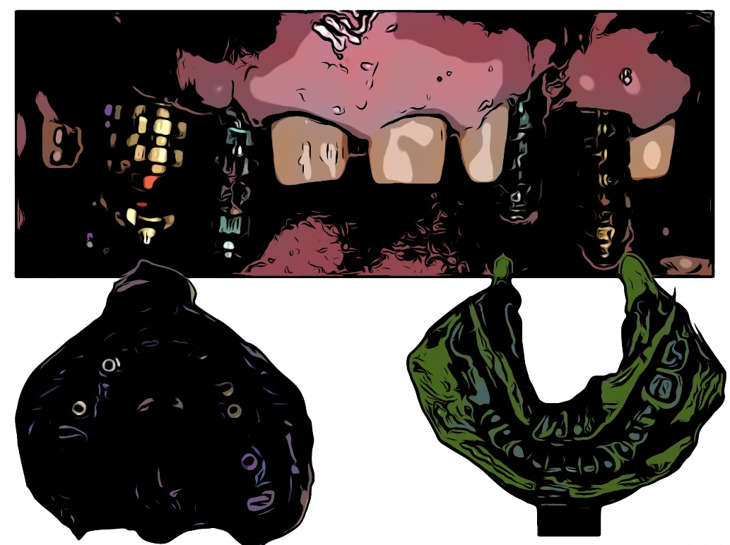
treatment
final impressions
description of technique (soft tissue handling, materials, etc.)
EPA

Slide 38
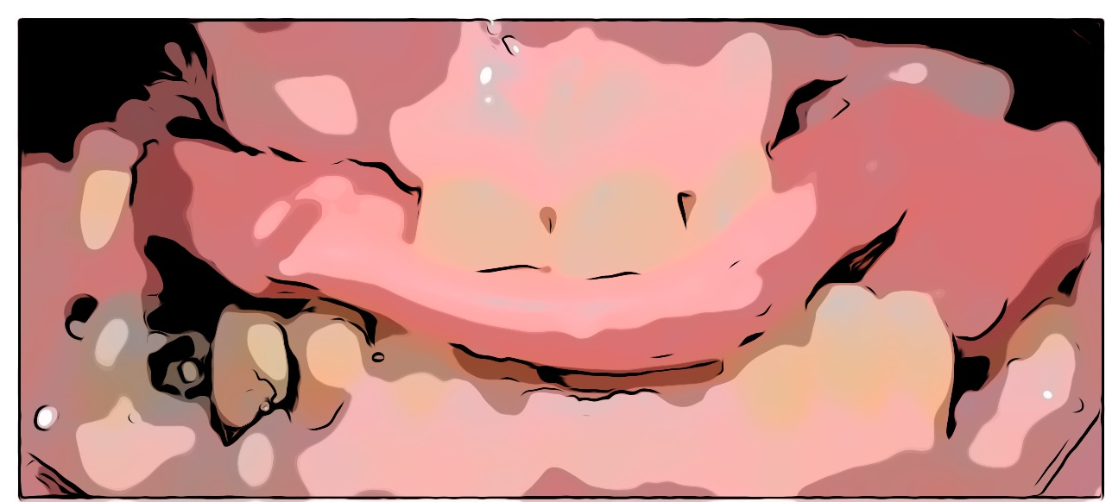
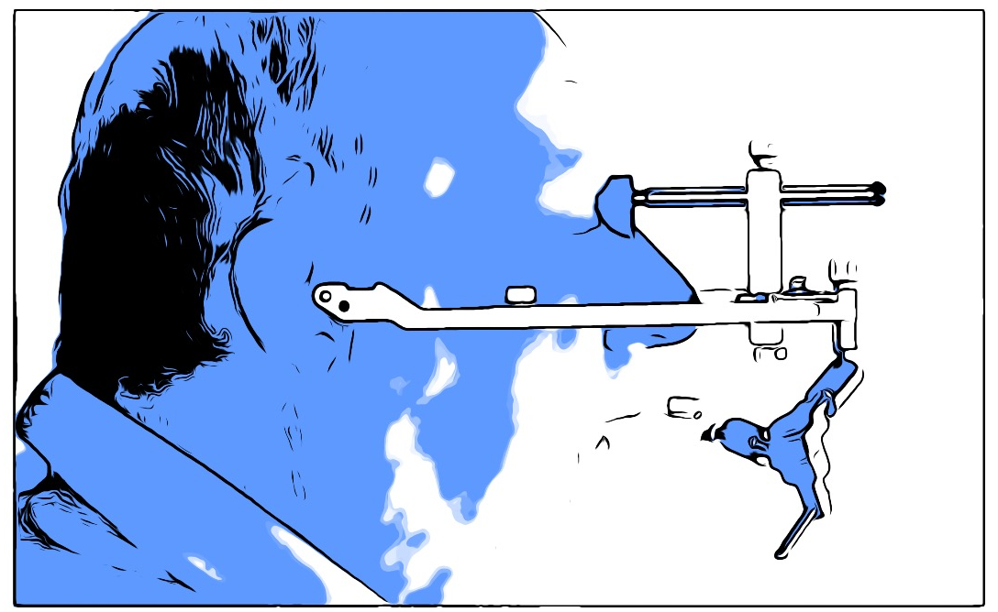
treatment
OCCLUSAL RECORDS
description of technique
EPA

Slide 39
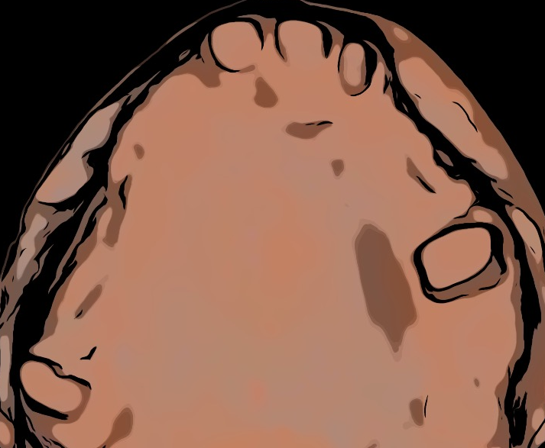
treatment
master casts
description of technique
EPA

Slide 40
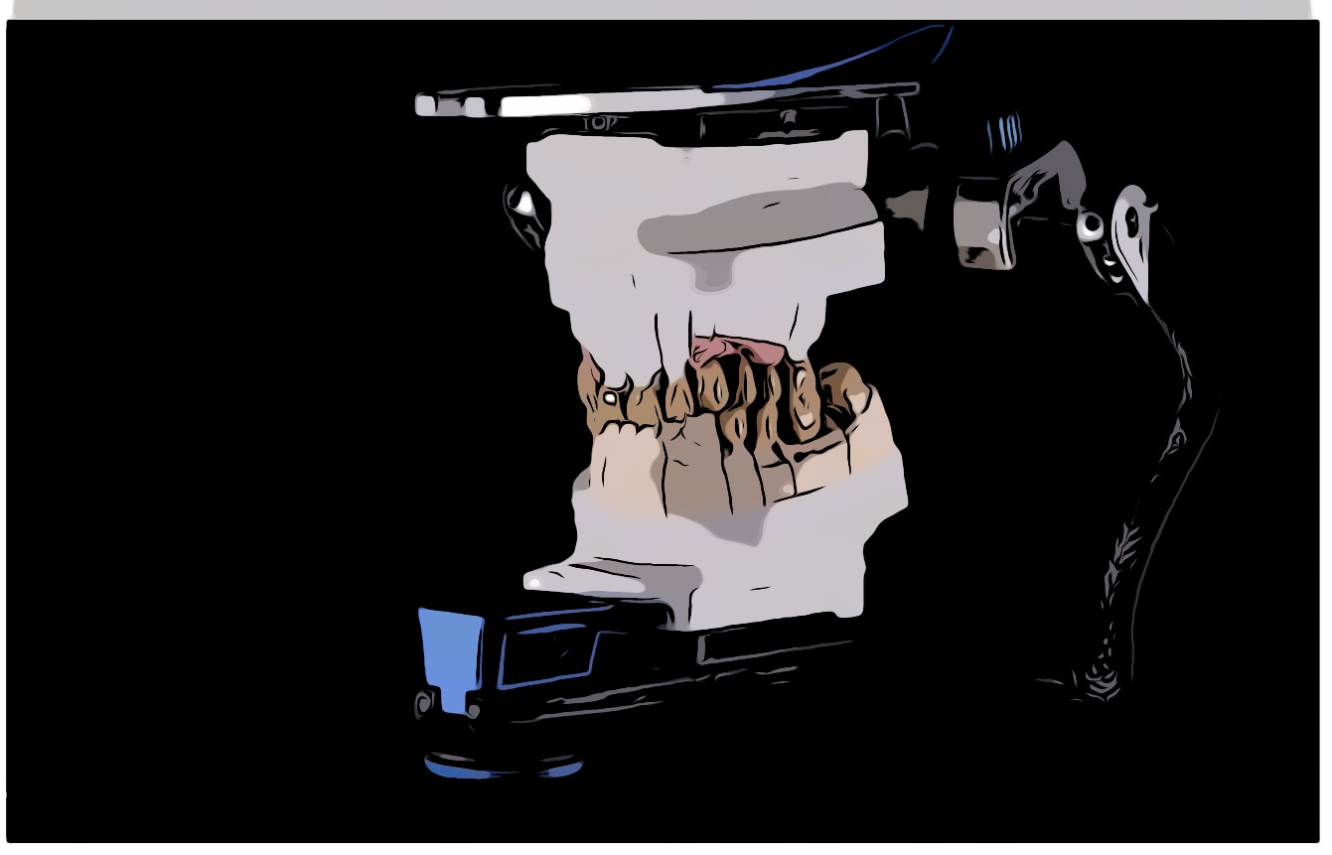
treatment
laboratory work
description of technique
EPA

Slide 41
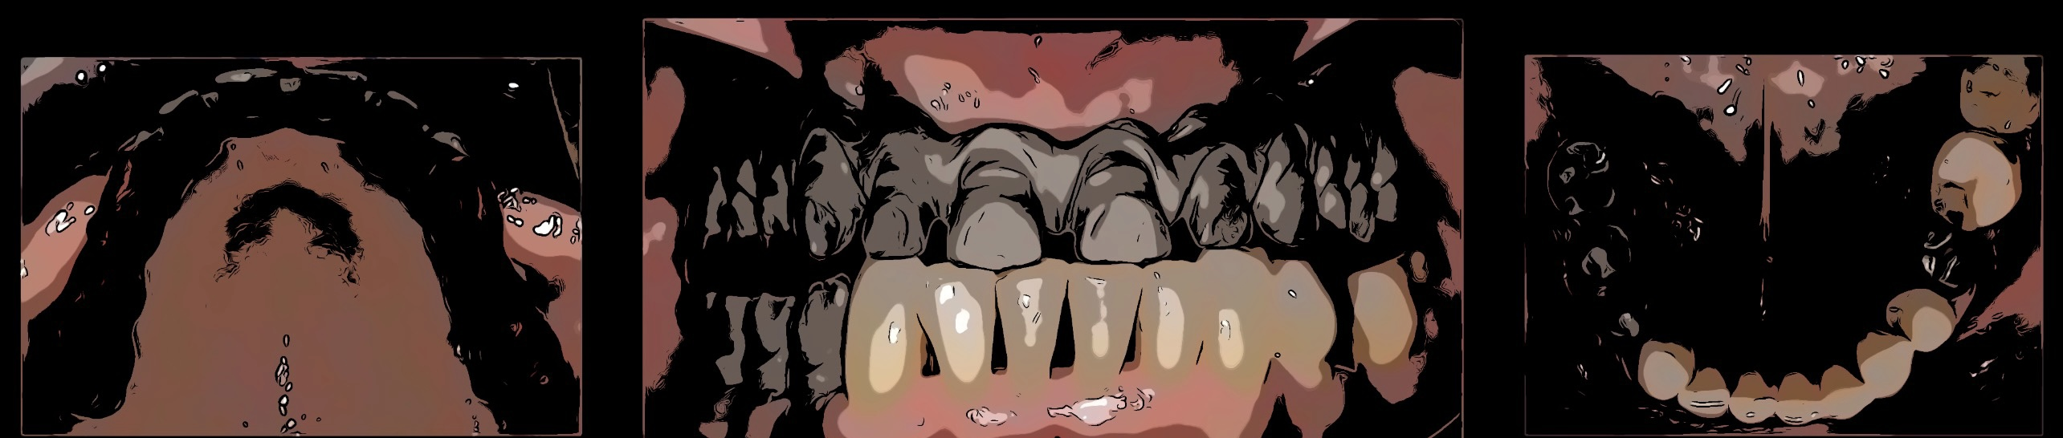
treatment
try-in
metal try-in
description of technique (materials, etc.)
if metal-ceramic
EPA

Slide 42
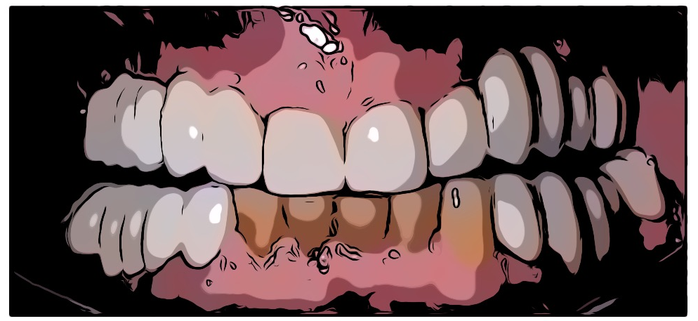
treatment
try-in
ceramic try-in
description of technique (materials, etc.)
EPA

Slide 43
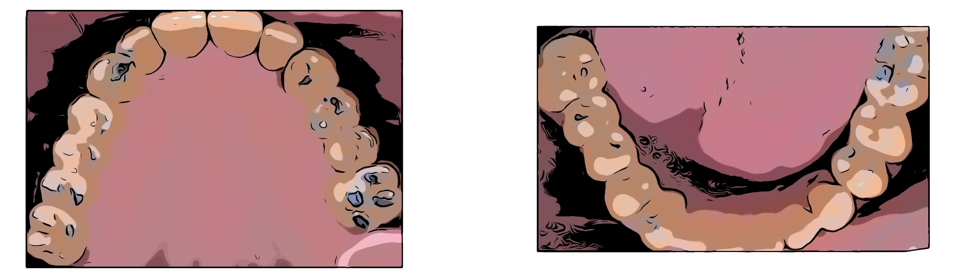
occlusal contacts
treatment
final results
description of occlusal scheme
EPA

Slide 44
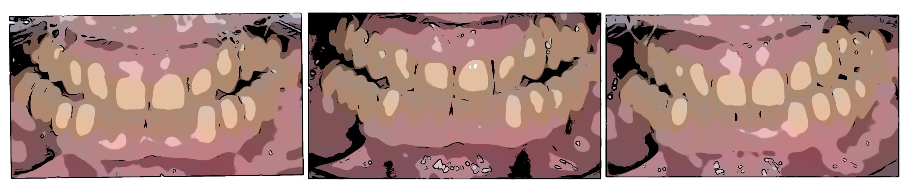
PROTRUSIVE AND LATERAL MOVEMENTS
treatment
final results
description of occlusal scheme
EPA

Slide 45
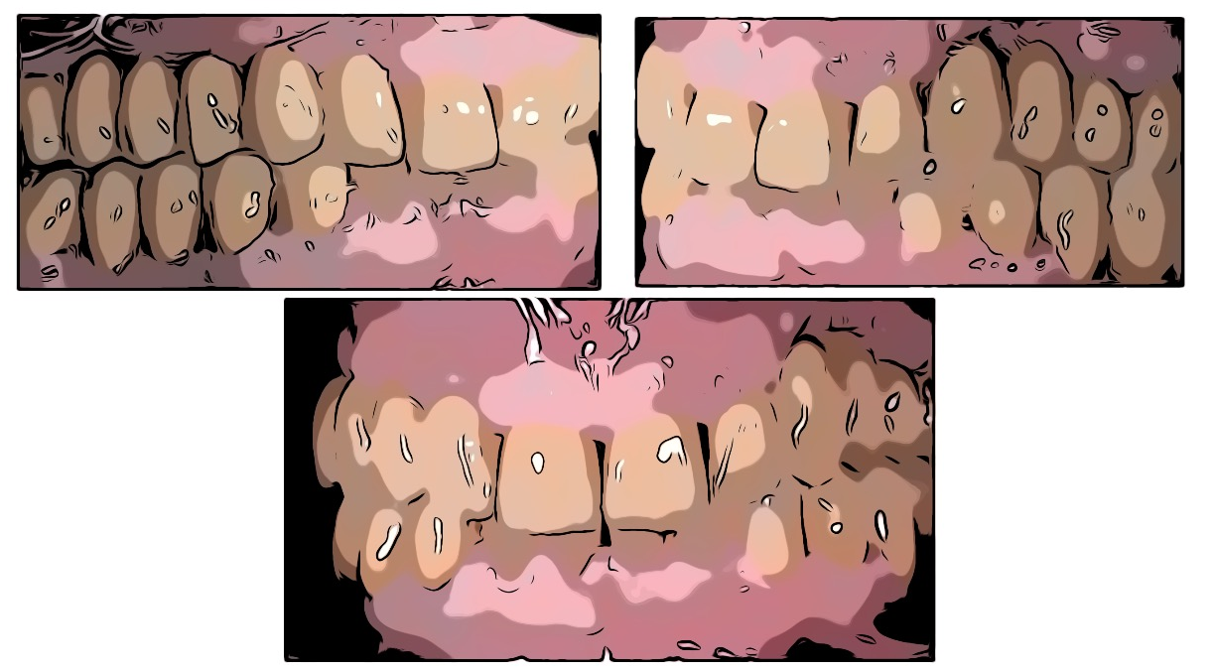
treatment
final results
EPA

Slide 46
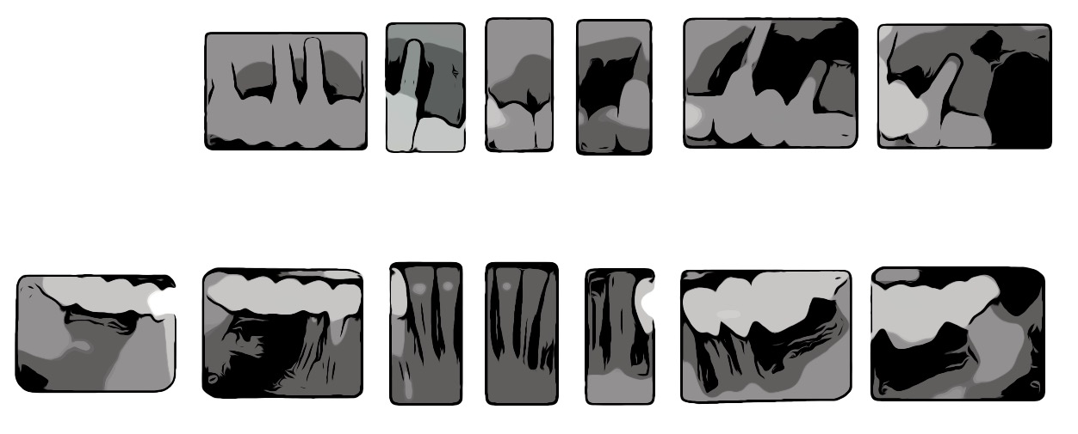
post-operative radiographs
treatment
final results
EPA

Slide 47
post-op radiographs
treatment
final results
post-operative periodontal chart
EPA

Slide 48
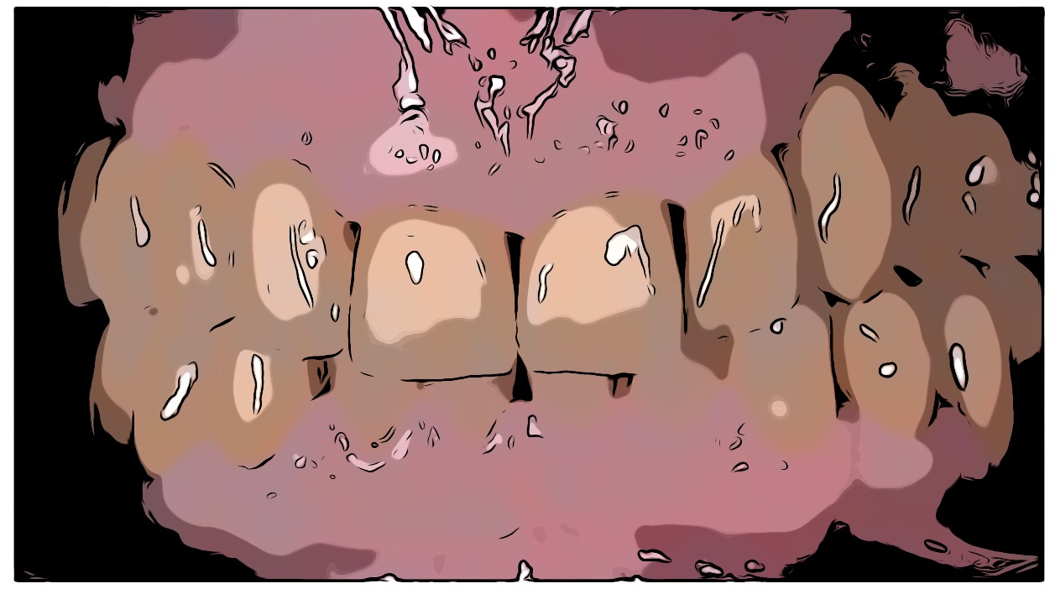
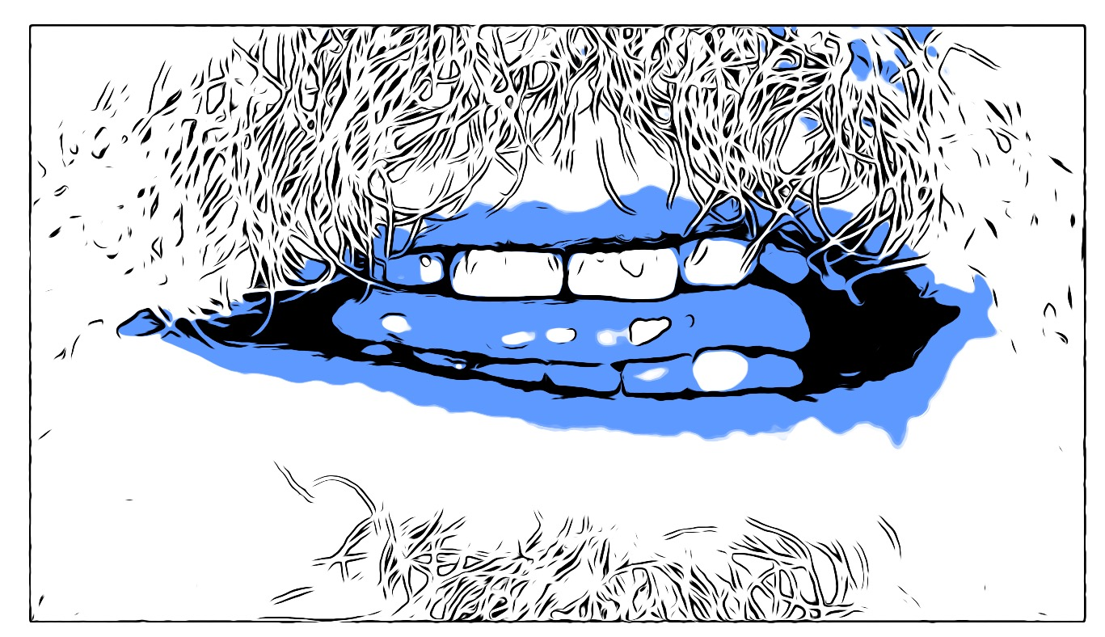
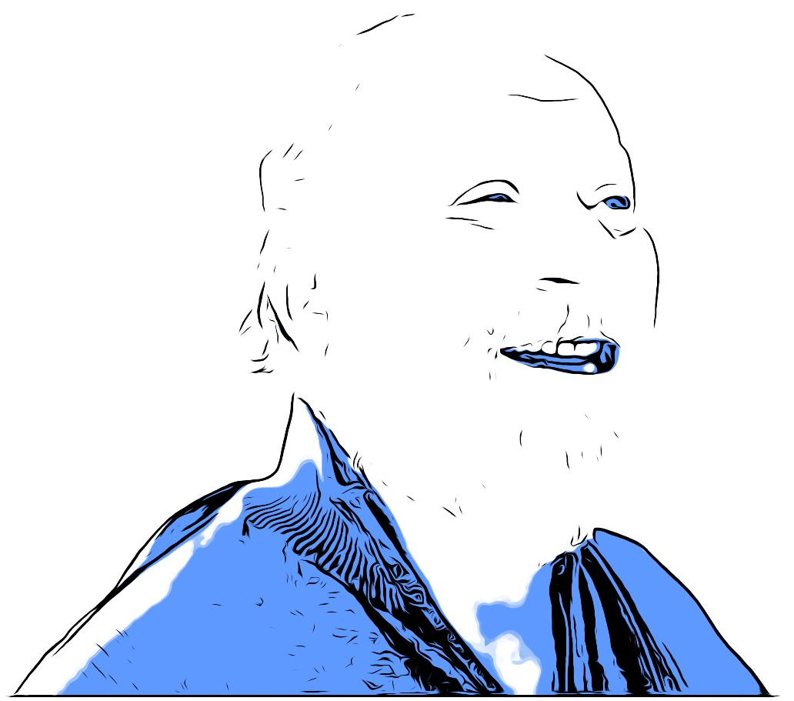
other views
treatment
final results
EPA

Slide 49
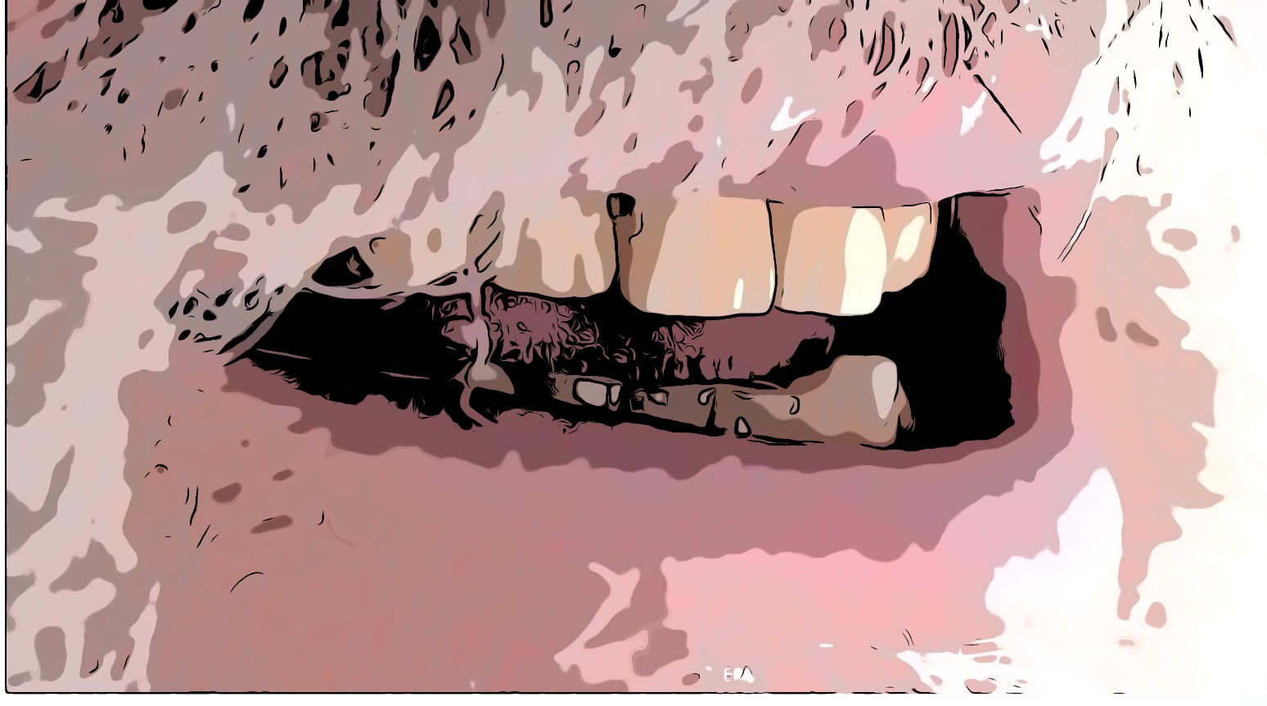
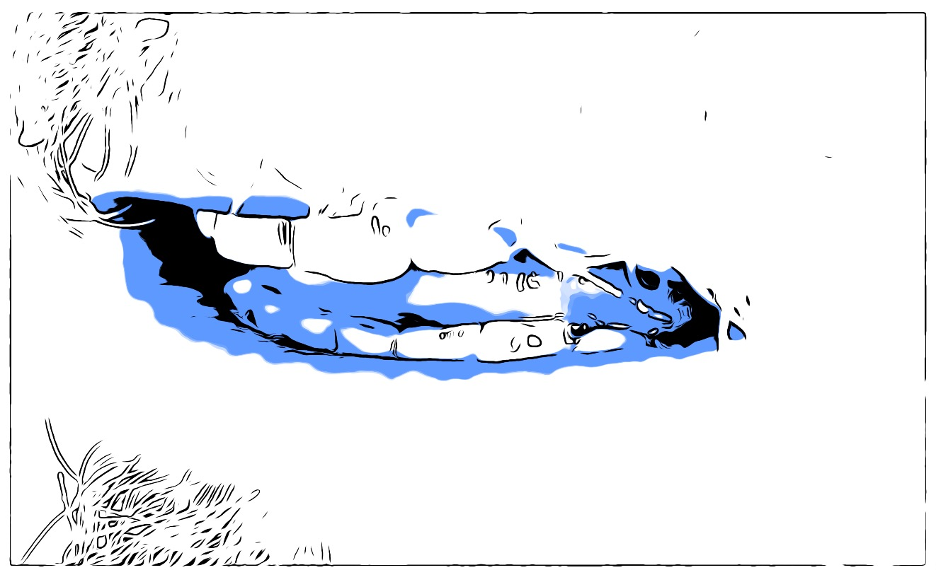
other views
treatment
final results
EPA

Slide 50
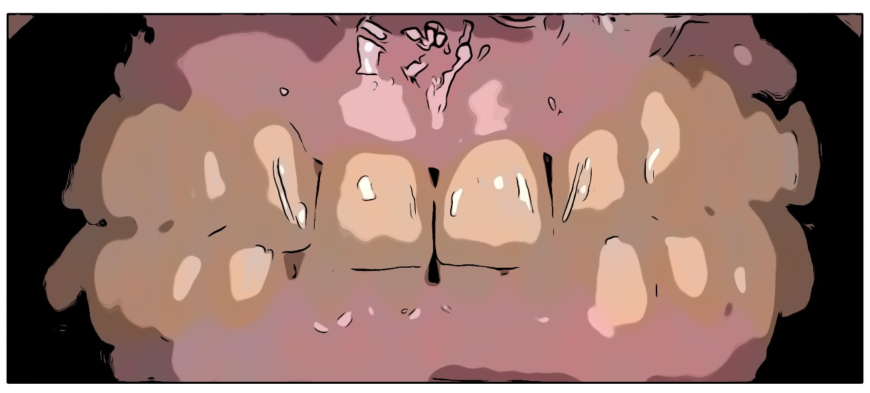
treatment
MAINTENANCE PROgram
description of maintenance program
EPA

Slide 51
follow-up evaluation
TIME OF FOLLOW-UP: (at least 1 year)
description of findings
EPA

Slide 52
follow-up evaluation
TIME OF FOLLOW-UP: (at least 1 year)
description of findings
EPA

Slide 53
follow-up evaluation
TIME OF FOLLOW-UP: (at least 1 year)
description of radiographic findings
EPA

Slide 54
case evaluation & personal reflections
before
after
reflections on therapies, results, prognosis, etc..
EPA

