Slide 1

APPLICATION FOR RECOGNITION OF PROSTHODONTIC SPECIALISATION
Dr Name Surname
Case Presentation n. 0
Topic:

Slide 2
Patient
Reason of referral
Age
Gender
Picture of the patient (full face and in profile)
Informed consent required for all images made and
used in the presentation.
(also when eyes are blurred or covered otherwise
main complaint
wish of the patient

Slide 3
Anamnesis
Dental history:
Medical history:
Profession/hobbies:
Psychosocial situation:
Medication:
ASA-score:

Slide 4
Dental anamnesis
History:
Oral hygiene:
Parafunctional activity:
Lifestyle related dental problems:

Slide 5
Clinical investigation
Extra oral
Intra oral
Periodontal screening (PPS):
Dutch Tooth Wear Score Index (DTWSI):
Soft tissues:
Caries activity: high-moderate-low
Restoration rate: high-moderate-low
TMJ:
Muscles:
Symmetry:
Mouth opening:
Rest position:
VDO

Slide 6
Function
Occlusion:
Mandibular stability:
Protrusive movements/contacts:
Right lateral movements/contacts:
Left lateral movements/contacts:
Envelop of function: restricted yes/no
Extra occlusal information ( e.g. T-scan):
Sagittal relation left/right:
Overjet (in mm):
Overbite (in mm):
Discrepancy CR-MO (in mm):
VDO (in mm):
Tongue position/movements:
Freeway space:

Slide 7
Status praesens
From dental software: patient record

Slide 8
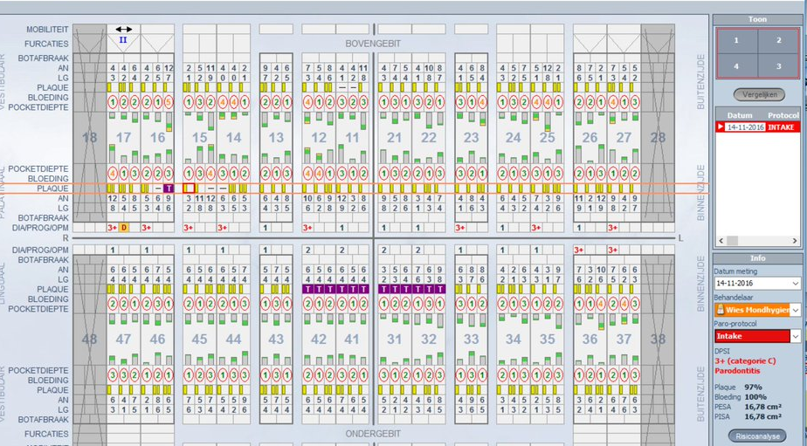
Periodontal situation
From dental software: patient record

Slide 9
Evaluation tooth wear (TWES)
Optional per case

Slide 10
Evaluation tooth wear (TWES)
B/L/P | 0 |  | 1 |  |  |  |  |  | 2
 | No (visible) wear |  | Wear only in enamel |  |  |  |  |  | Dentine exposure
Occlusal | 0 |  | 1a |  | 1b |  | 1c |  | 2 |  | 3a |  | 3b |  | 4
 | No (visible) wear |  | Minimal wear in enamel |  | Wear facets, parallel to normal contour |  | Big wear facets, flattening cusps and changing contours |  | Exposed dentine and loss of CC heigth <1/3 |  | Loss of CC height 1/3 - ½ |  | Loss of CC height 1/2 - 2/3 |  | Loss of CC height >2/3
Wetselaar P, Lobbezoo F. The tooth wear evaluation system: a modular clinical guideline for the diagnosis and management planning of worn dentitions. J Oral Rehabil. 2016 Jan;43(1):69-80

Slide 11
Evaluation tooth wear(TWES)
(this is an example)
 | 17 | 16 | 15 | 14 | 13 | 12 | 11 | 21 | 22 | 23 | 24 | 25 | 26 | 27
Buccal | - | 1 | 1 | 1 | 1 | 1 | 2 | 1 | 2 | 1 | 1 | 1 | 1 | -
Occlusal | - | 2 | 2 | 2 | 2 | 2 | 3a | 2 | 3a | 2 | 2 | 2 | 2 | -
Palatal | - | 1 | 1 | 1 | 2 | 2 | 2 | 2 | 2 | 2 | 1 | 1 | 1 | -
Palatal | 0 | 1 | 1 | 1 | 0 | 0 | 0 | 0 | 0 | 0 | 1 | 1 | 1 | -
Occlusal | 0 | 2 | 2 | 2 | 2 | 2 | 2 | 2 | 2 | 2 | 2 | 2 | 2 | -
Buccal | 0 | 2 | 1 | 1 | 1 | 1 | 1 | 1 | 1 | 1 | 1 | 2 | 2 | -
 | 47 | 46 | 45 | 44 | 43 | 42 | 41 | 31 | 32 | 33 | 34 | 35 | 36 | 37
Wetselaar P, Lobbezoo F. The tooth wear evaluation system: a modular clinical guideline for the diagnosis and management planning of worn dentitions. J Oral Rehabil. 2016 Jan;43(1):69-80

Slide 12
Radiographics
Bitewings + periapicals
OPT
CBCT ( if required)

Slide 13
Radiographic findings
Bitewings:
Periapicals:
OPT:
CBCT:

Slide 14
Study casts (plaster or digital)
Pictures of the casts occlusal and /or in articulator
Describe the dental observations

Slide 15
Pre-operative clinical pictures
(Facial pictures with closed mouth, smile and full tooth display)
Portrait
Mouth closed
Smile
Full tooth display
frontal
2x 45 degree
2x 90 degree

Slide 16

Intra oral pictures (use cheek retractors)
MIP

Slide 17
Intra oral pictures
End-to-end
No occlusal contact

Slide 18
Intra oral pictures
Upper front
Lower front

Slide 19
Intra oral pictures
Occlusal upper jaw Occlusal lower jaw

Slide 20
Intra oral pictures
In occlusion
left right

Slide 21
Facial Aesthetic analysis
Intermaxilary relation
Midline dental/facial
Occlusal plane
Lip position and tooth position
Buccal corridor
Visibility hard and soft tissues
Other:

Slide 22
Dental Aesthestic analysis
Condition and marginal gingiva (biotype, recessions, biologic width, papilla, guirlande, zeniths, etc.)
Width and shape front teeth
Morphology and color front teeth
Inclination and position front teeth

Slide 23
General risk analysis
Medical:
Personal:
Structural:
Functional:
Periodontal:
Endodontic:
Aesthetic:

Slide 24
Risico analyse per element
Risk analysis per tooth
 | 18 | 17 | 16 | 15 | 14 | 13 | 12 | 11 | 21 | 22 | 23 | 24 | 25 | 26 | 27 | 28
Parodontaal |  |  |  |  |  |  |  |  |  |  |  |  |  |  |  |  | P
Structureel |  |  |  |  |  |  |  |  |  |  |  |  |  |  |  |  | S
Endodontisch |  |  |  |  |  |  |  |  |  |  |  |  |  |  |  |  | E
Functioneel |  |  |  |  |  |  |  |  |  |  |  |  |  |  |  |  | F
Functioneel |  |  |  |  |  |  |  |  |  |  |  |  |  |  |  |  | F
Endodontisch |  |  |  |  |  |  |  |  |  |  |  |  |  |  |  |  | E
Structureel |  |  |  |  |  |  |  |  |  |  |  |  |  |  |  |  | S
Parodontaal |  |  |  |  |  |  |  |  |  |  |  |  |  |  |  |  | P
 | 48 | 47 | 46 | 45 | 44 | 43 | 42 | 41 | 31 | 32 | 33 | 34 | 35 | 36 | 37 | 38
In this example tooth 15 has a reasonable periodontal prognosis (copy/paste the dots)
GOOD
REASONABLE
QUEASTIONABLE
X
BAD

Slide 25
Diagnosis
Holistic description of the patient with his/her complaints + demands and expectations,
including all findings of the problems.

Slide 26
Aetiology
Possible cause of the problems
Prognosis without treatment?

Slide 27
Treatment options and altenatives
(with estimated prognosis per treatment option)
1)
2)
3)
(V. Kokich: “ let your treatment goal be realistic, not idealistic…”)

Slide 28
Treatment needs of other disciplines
Perio-, endo-, ortho-, implanto-, prostho/restorative, etc.
* Forming an interdisciplinary team. A key element in practicing with confidence and efficiency. Spear, F.M., IADA, vol.136, 2005

Slide 29
Backward planning
Digital smile design (if required)
Set-up / wax-up
Mock-up

Slide 30
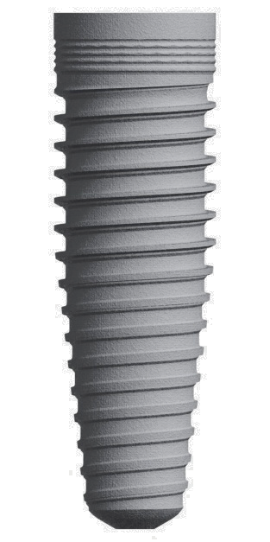
























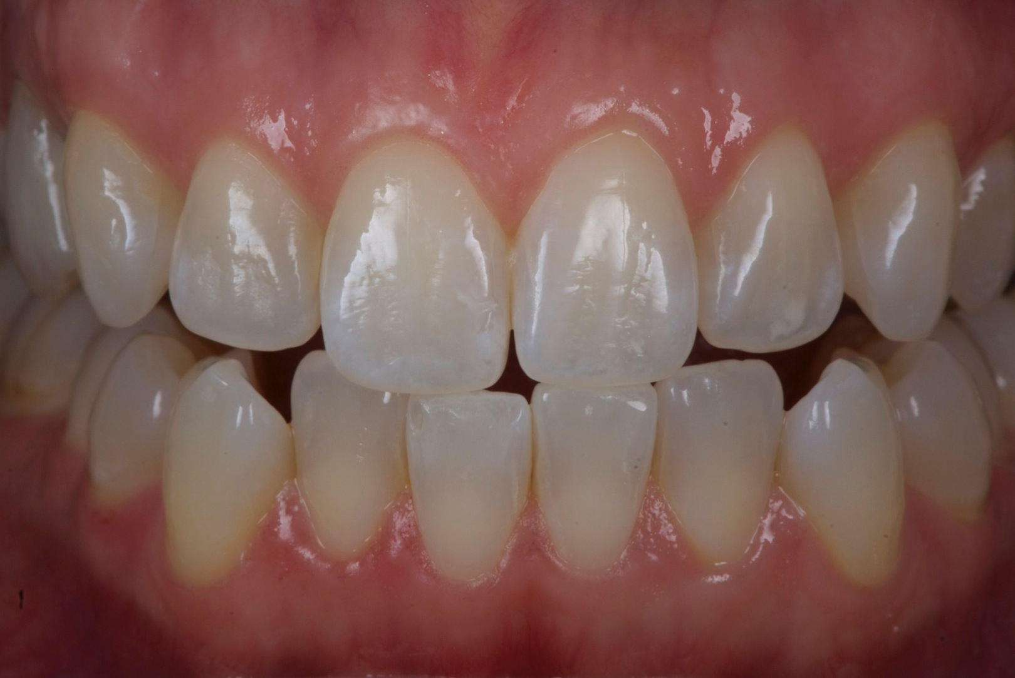
Tools DSD

Slide 31
Prosthetic/restorative planning
Treatment sequence
….
…
….
…

Slide 32
Execution of the treatment plan
(Step by step and Illustrated with relevant pictures (both intra-oral and rontgen) and details of lab work)

Slide 33
Final result
(Clinical pictures and radiographs)

Slide 34
Evaluation after one year
Pictures (both clinical and rontgen-) before and after one year

Slide 35
Evaluation after three years
(Pictures both clinical and rontgen- before and after three years)

Slide 36
Reflection
(Critical appraisal and prognosis)
Including relevant pictures and relevant literature
Materials used
What should I have done different now?
Longevity according to literature? (objective evaluation)
Evaluation selfcare and professional maintenance
Satisfaction of the patient (subjective evaluation)

Slide 37
Literature (example)
1. Spear FM. Forming an interdisciplinary team: a key element in practicing with confidence and efficiency. J Am Dent Assoc. 2005 Oct;136(10):1463-4.
2. Wetselaar P, Lobbezoo F. The tooth wear evaluation system: a modular clinical guideline for the diagnosis and management planning of worn dentitions. J Oral Rehabil. 2016 Jan;43(1):69-80
3. Magne P, Gallucci GO, Belser UC. Anatomic crown width/length ratios of unworn and worn maxillary teeth in white subjects. J Prosthet Dent. 2003 May;89(5):453-61.
4. Muts EJ, van Pelt H, Edelhoff D, Krejci I, Cune M. Tooth wear: a systematic review of treatment options. J Prosthet Dent. 2014 Oct;112(4):752-9.
5. Lindner S, Frasheri I, Hickel R, Crispin A, Kessler A. Retrospective clinical study on the performance and aesthetic outcome of pressed lithium disilicate restorations in posterior teeth up to 8.3 years. Clin Oral Investig. 2023 Dec;27(12):7383-7393.
6. Wöstmann B, Balkenhol M, Weber A, Ferger P, Rehmann P. Long-term analysis of telescopic crown retained removable partial dentures: survival and need for maintenance. J Dent. 2007 Dec;35(12):939-45.
IMPORTANT to sum up all relevant articles related tot treatment choice, material choice and prognosis.
8-10 references ( 5 must be recently published in hard core journals)

Slide 38
Acknowledgements
If applicable: Team members, dental technicians ………

